Slide 1
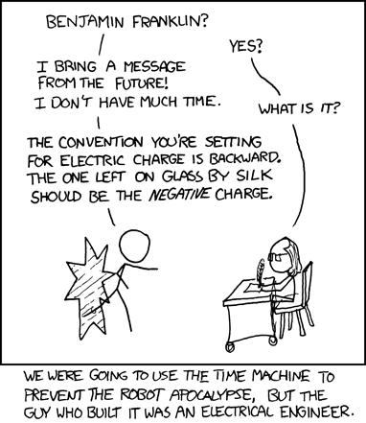
Electrical Engineering I
Andrew Hu

Slide 2

Administrivia
Attendance is still http://tinyurl.com/uwigem/18sp/attendance
William is starting on coding the wiki, and is looking for anyone interested in front-end web development
Github organization, did you get the email?
Anonymous Feedback, still a thing: http://tinyurl.com/uwigem/18sp/feedback

Slide 3

Administrivia 2: Trivia Harder
First software project (Pacman) is up and ready
Assignment details were posted on #drylab/Announcements
We’ll talk about it if we have time, near the end
Recommended to meet with your group at least once before you turn in your spec

Slide 4
Overview
How does electricity work?
How can this be used?
How can we use it to create a device and control it from a computer?

Slide 5
Preface
No prior knowledge is assumed
Don’t be scared!
I will teach you like a non-major, because neither am I
Technically, I have no formal education in EE :D
We’ll cover just a few core EE concepts, and go right into applications

Slide 6
The Basics
What is electricity?
What can it flow through?
The flow of electrons
Easily through conductors, potentially through insulators if voltage is high enough

Slide 7
The Basics
What causes electricity to start to flow?
What are some examples?
What is similar across these situations?
Plugging electronics into batteries or electrical outlets
Batteries and electrical outlets have (at least) two ends, the positive and negative

Slide 8

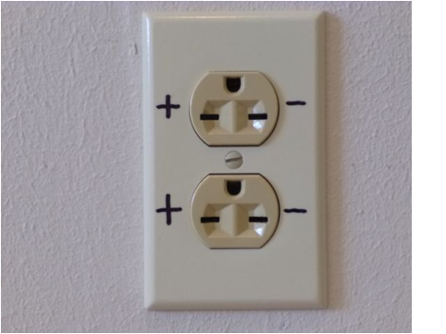
Positive & Negative
High electrical potential
Low electrical potential
When connected, electricity flows from high to low

Slide 9
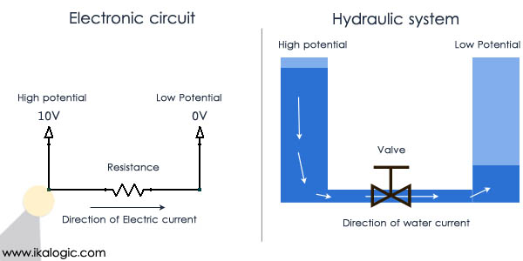
Water Flow Visualization

Slide 10
The Basics
How “fast” is the current flowing?
Depends on the material it has to cross through

Slide 11
Ohm’s Law
What did we say the “speed” of the current is?
It depends on the medium it’s travelling through
Ohm discovered the equation that relates the speed of electrical current, the “power” of the electrical source, and the medium of travel

Slide 12
Ohm’s Law
“V” means voltage of the electrical power source
“I” means the current of electrical flow
“R” means the resistance of the medium of travel
V = IR
Volts = Amps * Ohms(Ω)

Slide 13
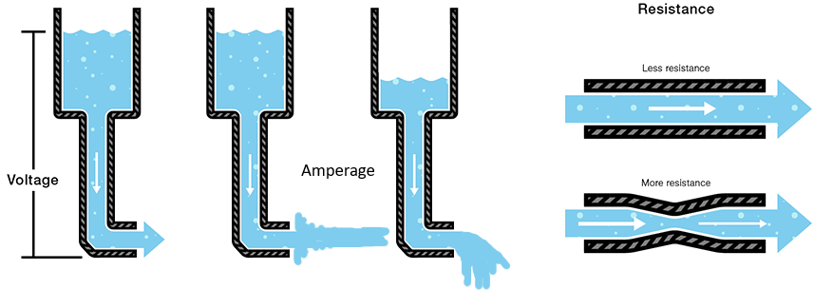
Ohm’s Water Slide
V = IR

Slide 14
Ohm’s Law: Rates
When voltage is increased, what happens to the current (I) if the resistance is held constant?
When resistance is increased, what happens to the current (I) if the voltage is held constant?
V = IR
The current will increase
The current will decrease

Slide 15
Water Pressure Over Distance
You are going out to wash your car, but the hose is in the back yard
You test the hose on full blast in the backyard
You run the hose to the driveway, and turn it on full blast
Is the force of the water any different?
No, each water molecule pushes on each other in a line, so as long as there aren’t any obstructions, the force stays the same

Slide 16
Preservation of Voltage Over Distance
No matter the distance of wire, the voltage will be the same
Each water molecule pushes on each other in a line
Similarly, each electron pushes on each other in a circuit

Slide 17
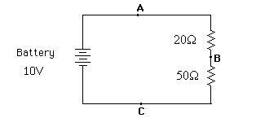
Circuit Diagrams
We assume that normal wire has negligible resistance

Slide 18
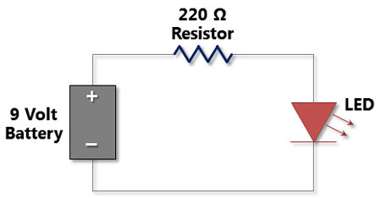
Resistance is Futile
What is the speed of the current in this circuit? (assume LED has ~0 Ohm resistance)
V = IR
9V = 220Ω * R
R = 9/220 = 41mA

Slide 19
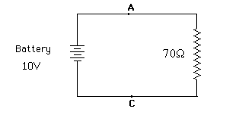
Series Connections
When elements are in a line on the wire, they are “in series”
Resistors in series act as one big resistor

Slide 20
Le Piece de Resistance
What is the current in each of these points?
V = IR

Slide 21

No Resistors?
What is the current in this circuit?
Very high!
(short circuit)
5V

Slide 22
Short Circuits
Caused by having very little resistance
Electricity flows very quickly
Drains your power source
The cause of 99% of your safety risks!

Slide 23
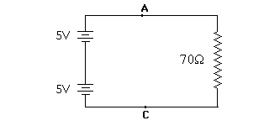
Series
Voltage is also added in series

Slide 24
Series
All equal!

Slide 25
Safety
It takes 100mA to stop your heart
Your body* has ~1,000 Ohms of resistance
You do the math: 100V can kill you
11 9-Volt batteries linked in series
ANY appliance hooked up to the wall can kill you if you drop it in the bathtub

Slide 26
Software: Pacman Project
Project details posted on Zulip, groups have been assigned
Week 1: Write the spec!
Meet with your group to discuss how to divide up the work
Make design decisions about what work will be handled by which parts
Write the method signatures
Comment them with Javadoc-style comments
I have a script to generate Javadoc for Processing files, you don’t need to do it yourself

